Slide 1
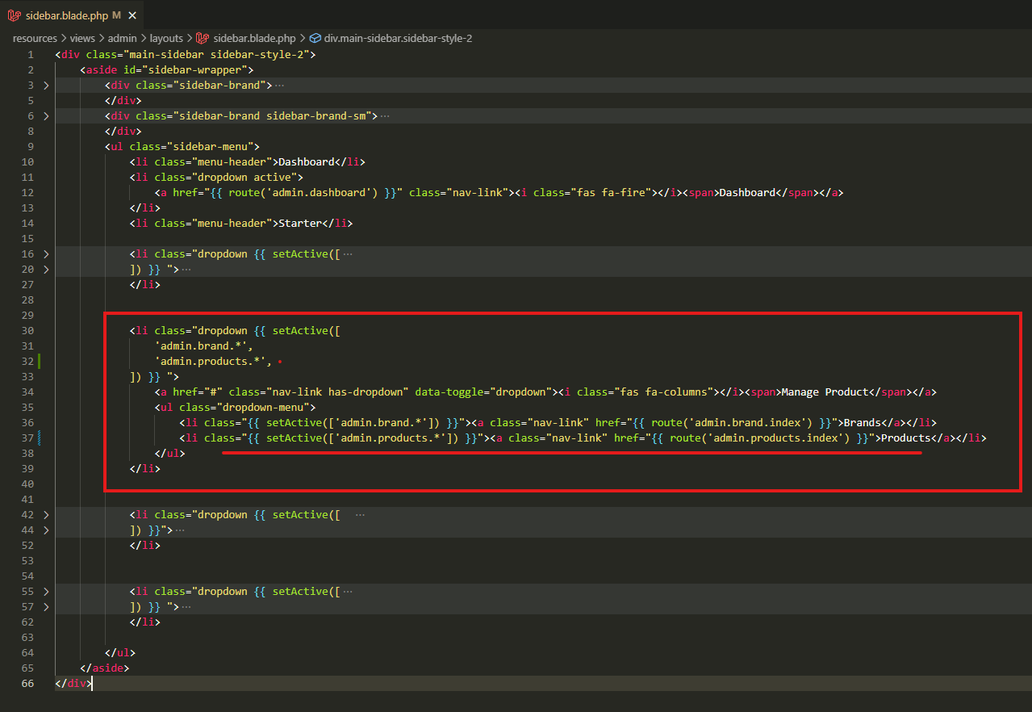
resources\views\admin\layouts\sidebar.blade.php

Slide 2
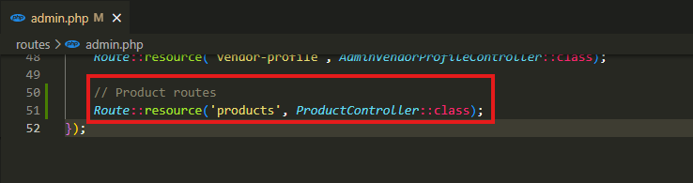
routes\admin.php

Slide 3
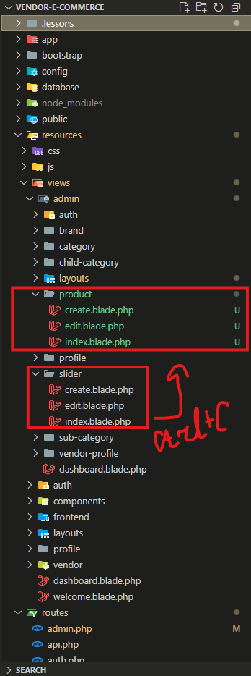
.

Slide 4
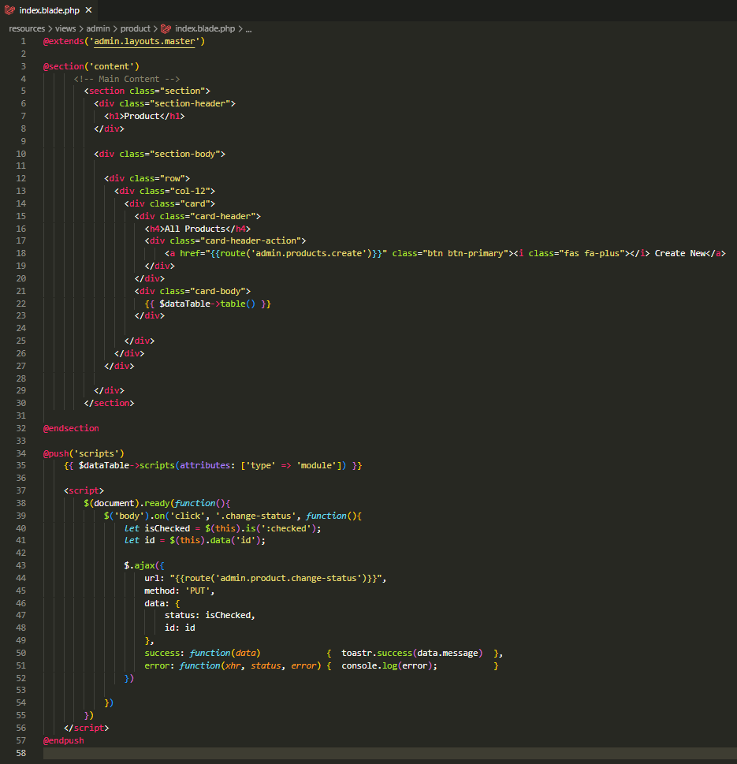
resources\views\admin\product\index.blade.php

Slide 5
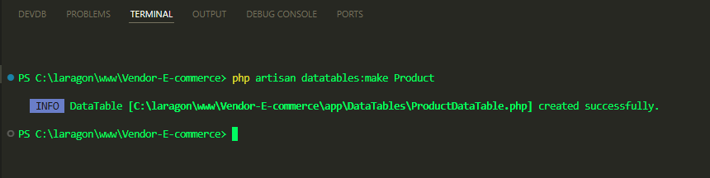
.

Slide 6
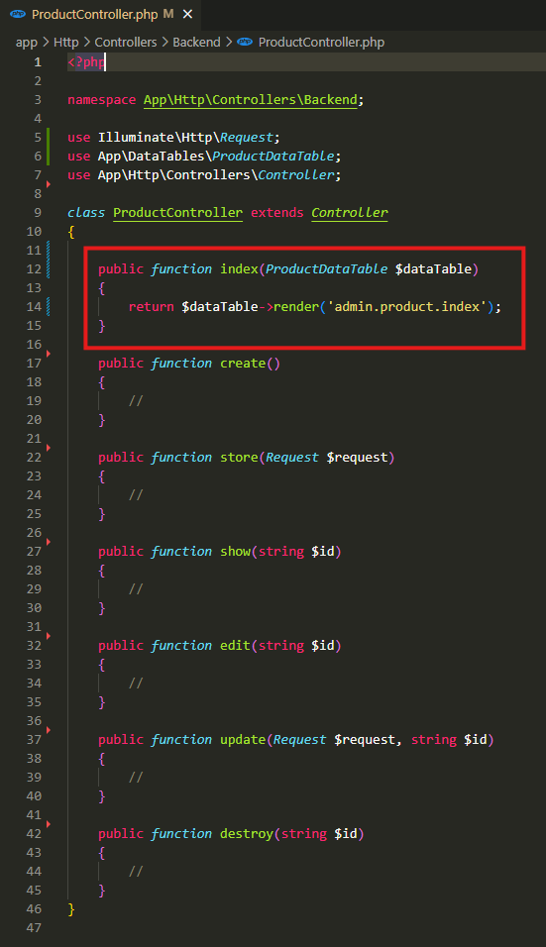
app\Http\Controllers\Backend\ProductController.php

Slide 7
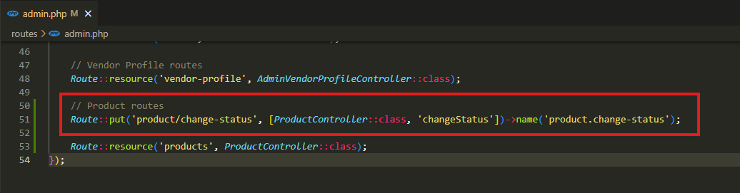
.

Slide 8
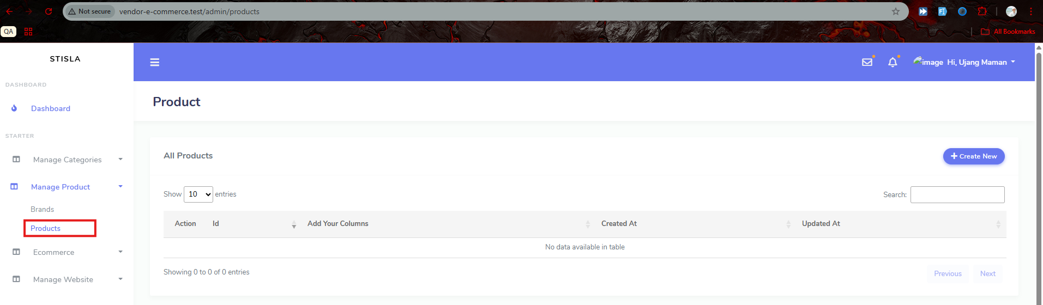
.

Slide 9
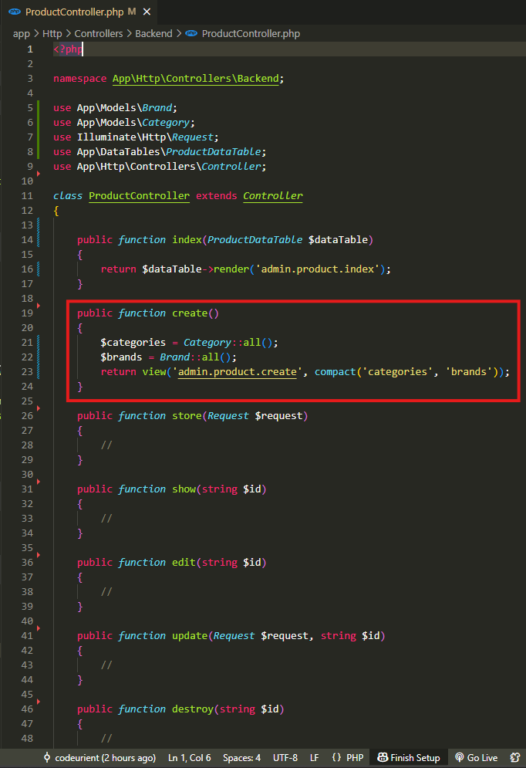
app\Http\Controllers\Backend\ProductController.php

Slide 10
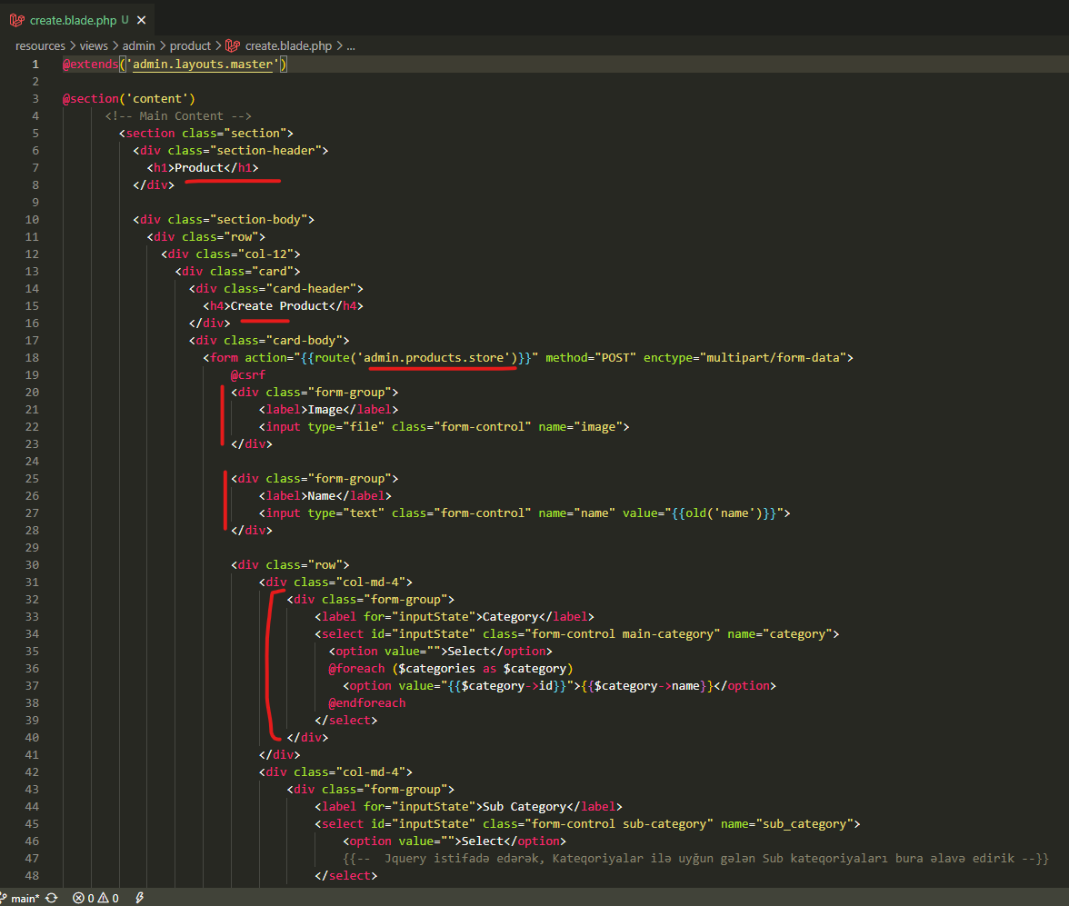
resources\views\admin\product\create.blade.php

Slide 11
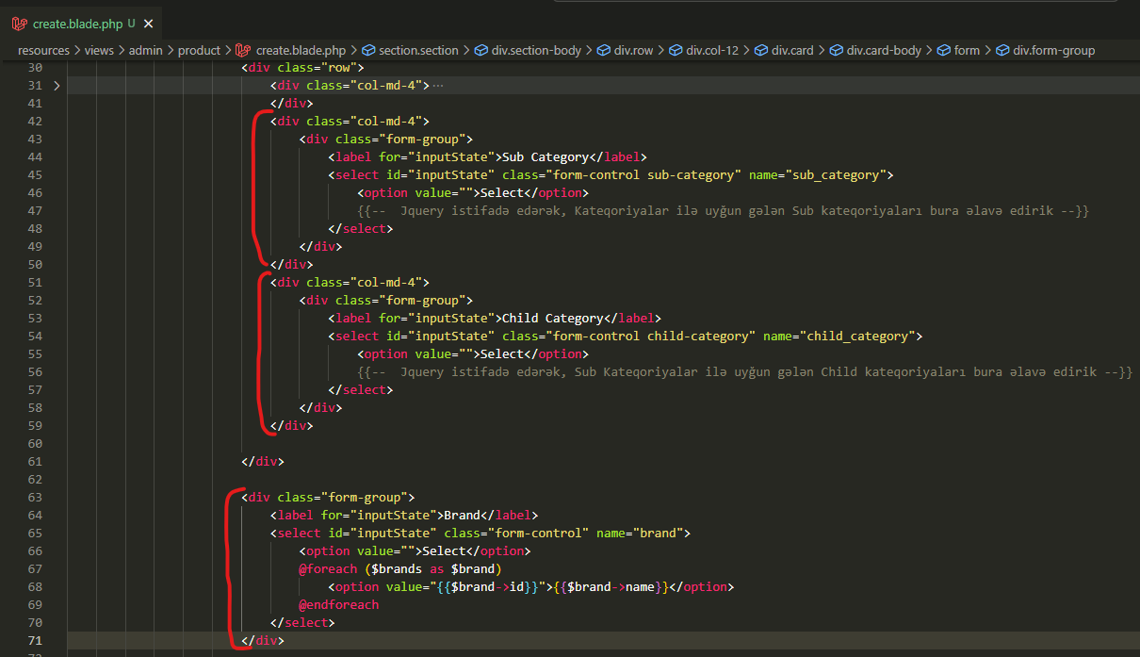
resources\views\admin\product\create.blade.php

Slide 12
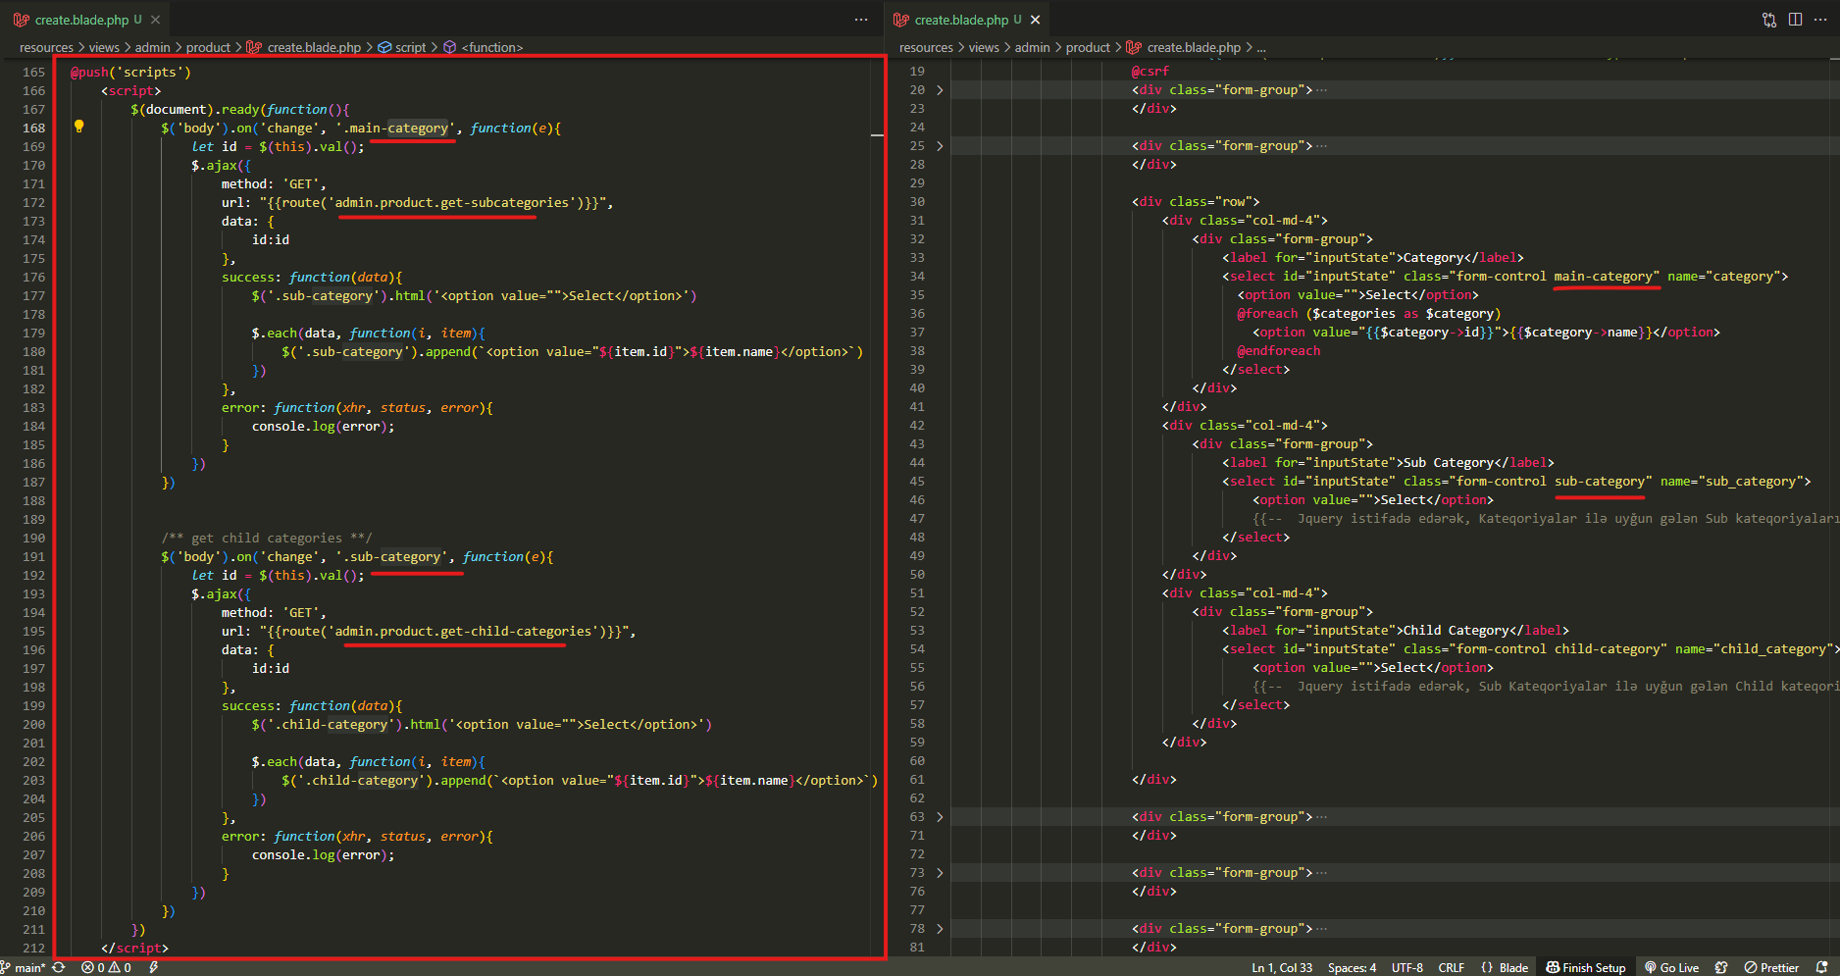
resources\views\admin\product\create.blade.php

Slide 13
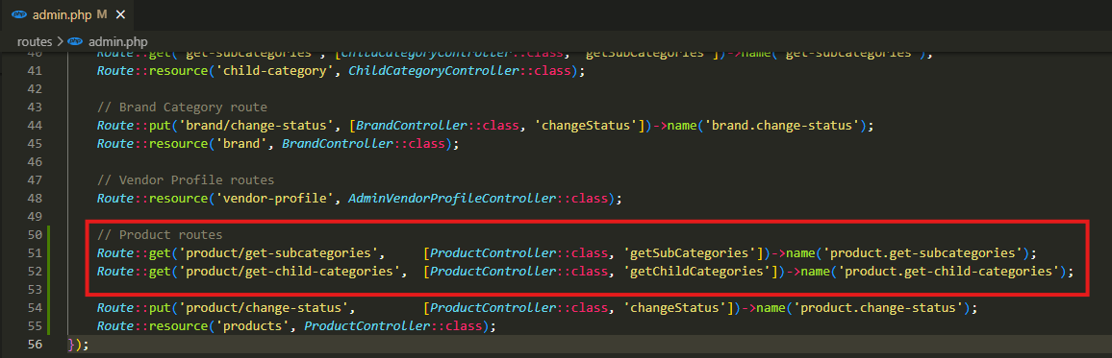
.

Slide 14
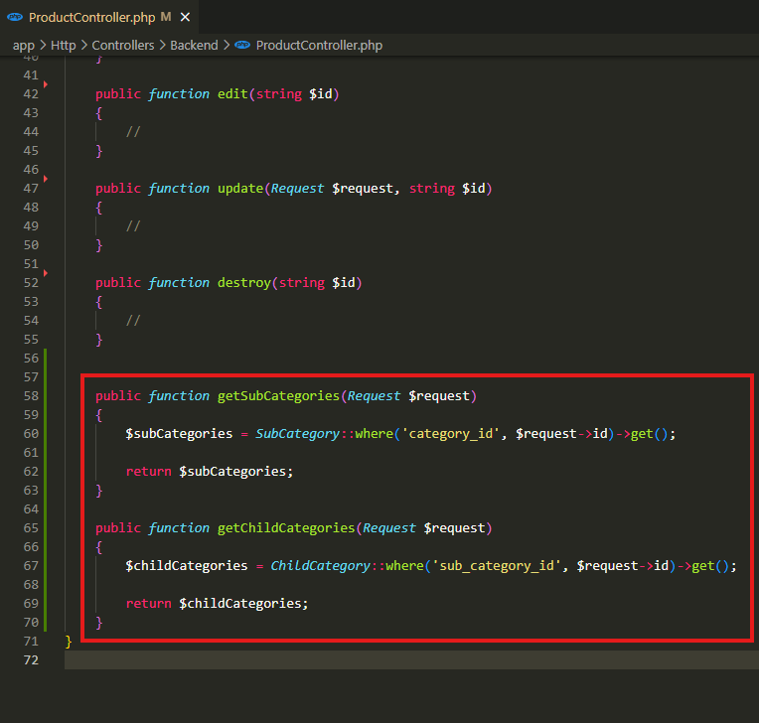
app\Http\Controllers\Backend\ProductController.php

Slide 15
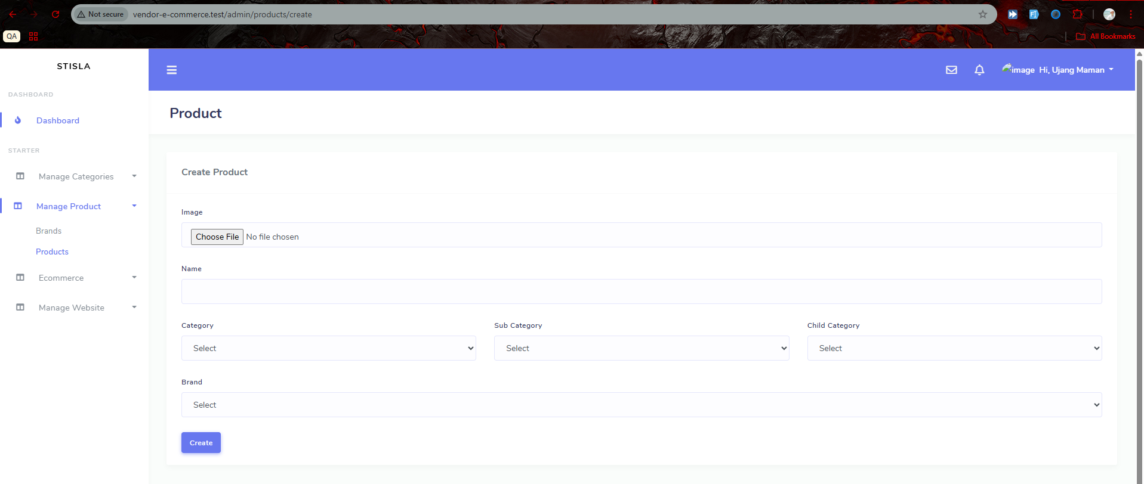
.

Slide 16
.

Slide 17
.

